Slide 1
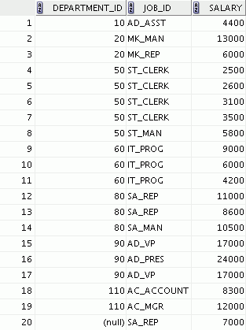
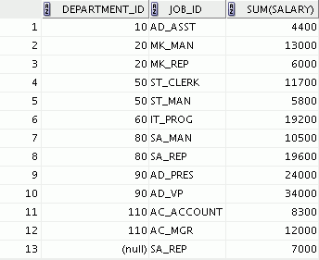
Grouping by More Than One Column
EMPLOYEES
Add the
salaries in
the EMPLOYEES
table for
each job,
grouped by
department
Notes:
Oracle Database 10g: SQL Fundamentals I 4 - <number>
Groups Within Groups
Sometimes you need to see results for groups within groups. The slide shows a report that displays the total salary that is paid to each job title in each department.
The EMPLOYEES table is grouped first by department number and then by job title within that grouping. For example, the four stock clerks in department 50 are grouped together, and a single result (total salary) is produced for all stock clerks in the group.

Slide 3
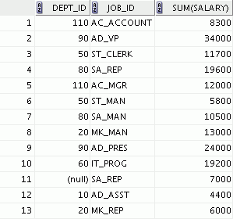
Using the GROUP BY Clause on Multiple Columns
SELECT department_id dept_id, job_id, SUM(salary)
FROM employees
GROUP BY department_id, job_id ;
Notes:
Oracle Database 10g: SQL Fundamentals I 4 - <number>
Groups Within Groups (continued)
You can return summary results for groups and subgroups by listing more than one GROUP BY column. You can determine the default sort order of the results by the order of the columns in the GROUP BY clause. In the slide example, the SELECT statement containing a GROUP BY clause is evaluated as follows:
The SELECT clause specifies the column to be retrieved:
Department number in the EMPLOYEES table
Job ID in the EMPLOYEES table
The sum of all the salaries in the group that you specified in the GROUP BY clause
The FROM clause specifies the tables that the database must access: the EMPLOYEES table.
The GROUP BY clause specifies how you must group the rows:
First, the rows are grouped by department number.
Second, the rows are grouped by job ID in the .
So the SUM function is applied to the salary column for all job IDs in each department number group.

Slide 4
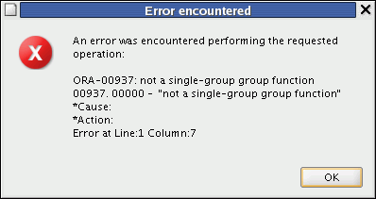
Illegal Queries
Using Group Functions
Any column or expression in the SELECT list that is not an aggregate function must be in the GROUP BY clause:
SELECT department_id, COUNT(last_name)
FROM employees;
Column missing in the GROUP BY clause
Notes:
Oracle Database 10g: SQL Fundamentals I 4 - <number>
Illegal Queries Using Group Functions
Whenever you use a mixture of individual items (DEPARTMENT_ID) and group functions (COUNT) in the same SELECT statement, you must include a GROUP BY clause that specifies the individual items (in this case, DEPARTMENT_ID). If the GROUP BY clause is missing, then the error message “not a single-group group function” appears. You can correct the error in the slide by adding the GROUP BY clause:
SELECT department_id, count(last_name)
FROM employees
GROUP BY department_id;
Any column or expression in the SELECT list that is not an aggregate function must be in the GROUP BY clause.

Slide 5
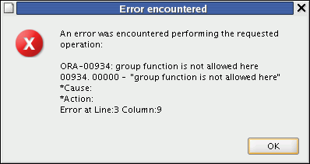
Illegal Queries
Using Group Functions
  You cannot use the WHERE clause to restrict groups.
  You use the HAVING clause to restrict groups.
  You cannot use group functions in the WHERE clause.
SELECT department_id, AVG(salary)
FROM employees
WHERE AVG(salary) > 8000
GROUP BY department_id;
Cannot use the WHERE clause
to restrict groups
Notes:
Oracle Database 10g: SQL Fundamentals I 4 - <number>
Illegal Queries Using Group Functions (continued)
The WHERE clause cannot be used to restrict groups. The SELECT statement in the slide example results in an error because it uses the WHERE clause to restrict the display of average salaries of those departments that have an average salary greater than $8,000.
You can correct the error in the example by using the HAVING clause to restrict groups:
SELECT department_id, AVG(salary)
FROM employees
HAVING AVG(salary) > 8000
GROUP BY department_id;

Slide 6
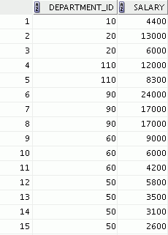

Restricting Group Results
EMPLOYEES
The maximum
salary
per department
when it is
greater than
$10,000
…
Notes:
Oracle Database 10g: SQL Fundamentals I 4 - <number>
Restricting Group Results
In the same way that you use the WHERE clause to restrict the rows that you select, you use the HAVING clause to restrict groups. To find the maximum salary in each of the departments that have a maximum salary greater than $10,000, you need to do the following:
1. Find the average salary for each department by grouping by department number.
2. Restrict the groups to those departments with a maximum salary greater than $10,000.

Slide 7
Restricting Group Results with the HAVING Clause
When you use the HAVING clause, the Oracle server restricts groups as follows:
  Rows are grouped.
  The group function is applied.
  Groups matching the HAVING clause are displayed.
SELECT column, group_function
FROM table
[WHERE condition]
[GROUP BY group_by_expression]
[HAVING group_condition]
[ORDER BY column];
Notes:
Oracle Database 10g: SQL Fundamentals I 4 - <number>
Restricting Group Results with the HAVING Clause
You use the HAVING clause to specify which groups are to be displayed, thus further restricting the groups on the basis of aggregate information.
In the syntax, group_condition restricts the groups of rows returned to those groups for which the specified condition is true.
The Oracle server performs the following steps when you use the HAVING clause:
1. Rows are grouped.
2. The group function is applied to the group.
3. The groups that match the criteria in the HAVING clause are displayed.
The HAVING clause can precede the GROUP BY clause, but it is recommended that you place the GROUP BY clause first because that is more logical. Groups are formed and group functions are calculated before the HAVING clause is applied to the groups in the SELECT list.

Slide 8
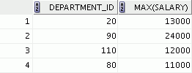
Using the HAVING Clause
SELECT department_id, MAX(salary)
FROM employees
GROUP BY department_id
HAVING MAX(salary)>10000 ;
Notes:
Oracle Database 10g: SQL Fundamentals I 4 - <number>
Using the HAVING Clause
The slide example displays department numbers and maximum salaries for those departments with a maximum salary that is greater than $10,000.
You can use the GROUP BY clause without using a group function in the SELECT list.
If you restrict rows based on the result of a group function, you must have a GROUP BY clause as well as the HAVING clause.
The following example displays the department numbers and average salaries for those departments with a maximum salary that is greater than $10,000:
SELECT department_id, AVG(salary)
FROM employees
GROUP BY department_id
HAVING max(salary)>10000;

Slide 9

Using the HAVING Clause
SELECT job_id, SUM(salary) PAYROLL
FROM employees
WHERE job_id NOT LIKE '%REP%'
GROUP BY job_id
HAVING SUM(salary) > 13000
ORDER BY SUM(salary);
Notes:
Oracle Database 10g: SQL Fundamentals I 4 - <number>
Using the HAVING Clause (continued)
The slide example displays the job ID and total monthly salary for each job that has a total payroll exceeding $13,000. The example excludes sales representatives and sorts the list by the total monthly salary.

Slide 10

Nesting Group Functions
Display the maximum average salary:
SELECT MAX(AVG(salary))
FROM employees
GROUP BY department_id;
Notes:
Oracle Database 10g: SQL Fundamentals I 4 - <number>
Nesting Group Functions
Group functions can be nested to a depth of two. The slide example displays the maximum average salary.

Slide 11
Summary
In this lesson, you should have learned how to:
  Use the group functions COUNT, MAX, MIN, and AVG
  Write queries that use the GROUP BY clause
  Write queries that use the HAVING clause
SELECT column, group_function
FROM table
[WHERE condition]
[GROUP BY group_by_expression]
[HAVING group_condition]
[ORDER BY column];
Notes:
Oracle Database 10g: SQL Fundamentals I 4 - <number>
Summary
Several group functions are available in SQL, such as the following:
AVG, COUNT, MAX, MIN, SUM, STDDEV, and VARIANCE
You can create subgroups by using the GROUP BY clause. Groups can be restricted using the HAVING clause.
Place the HAVING and GROUP BY clauses after the WHERE clause in a statement. The order of the HAVING and GROUP clauses following the WHERE clause is not important. Place the ORDER BY clause last.
The Oracle server evaluates the clauses in the following order:
1. If the statement contains a WHERE clause, the server establishes the candidate rows.
2. The server identifies the groups that are specified in the GROUP BY clause.
3. The HAVING clause further restricts result groups that do not meet the group criteria in the HAVING clause.
Note: For a complete list of the group functions, see Oracle SQL Reference.

